Slide 1
CYBR 493A
Introduction
Lecture 1.A. : Introduction to Linux and Version Control
Pages 1-11

Slide 2
TOPICS
Costs of Data Breach Report 2021.
Gentle Intro. To Linux.
Common Linux commands to know
Absolute vs. Relative paths
Introduction to Version Control
Working with Git and GitHub
Introduction to Python

Slide 3
Let's talk Version Control
Version Control Systems are essential in developing computer software

Slide 4
Introduction to Version Control
Version Control, sometimes referred to as “revision control”, “source control”, and “source code management”, is a process of tracking changes to files over time.
One of the main goals of version control is to track changes that occur so that they can be reviewed and if necessary, rolled-back.

Slide 5
Version Control Systems
Imagine that you and your group members are working on a project/ paper
Each must contribute by adding files/ text
How do we track contributions?
What if somebody “deletes” content, can we retrieve them?

Slide 6
Version Control Systems: Git
There are a lot of version control systems in existence today. For this class we will be focusing on using Git:
A “distributed version control” system. Meaning you can keep a local repository on your computer (including history), and synchronize it with a remote repository

Slide 7
Working with Git and GitHub
You will need to create an account with Github
We will use the book’s repository as an example
Copy a template repo
Clone the repo to your local machine

Slide 8
Creating a GitHub account
To begin we will create an account on GitHub. To start:
Open a web browser and go to https://github.com
On the GitHub home page, click Sign up.
On the Create your account page, enter your desired Username, Email address (use Mix please) and Password.
Click to verify your account and solve the puzzle presented.

Slide 9
Cloning our repo
Now that we have an account on GitHub, we can start by cloning our repository
The book has a sample repository that can we can use to begin our process.
It is integrated in our main repo

Slide 10
Github Desktop
You may also use a user-friendly application named Github Desktop
You can do everything using the Github Desktop application.

Slide 11
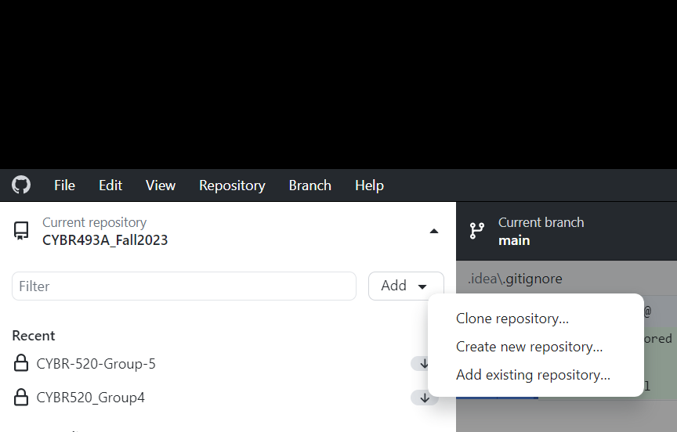
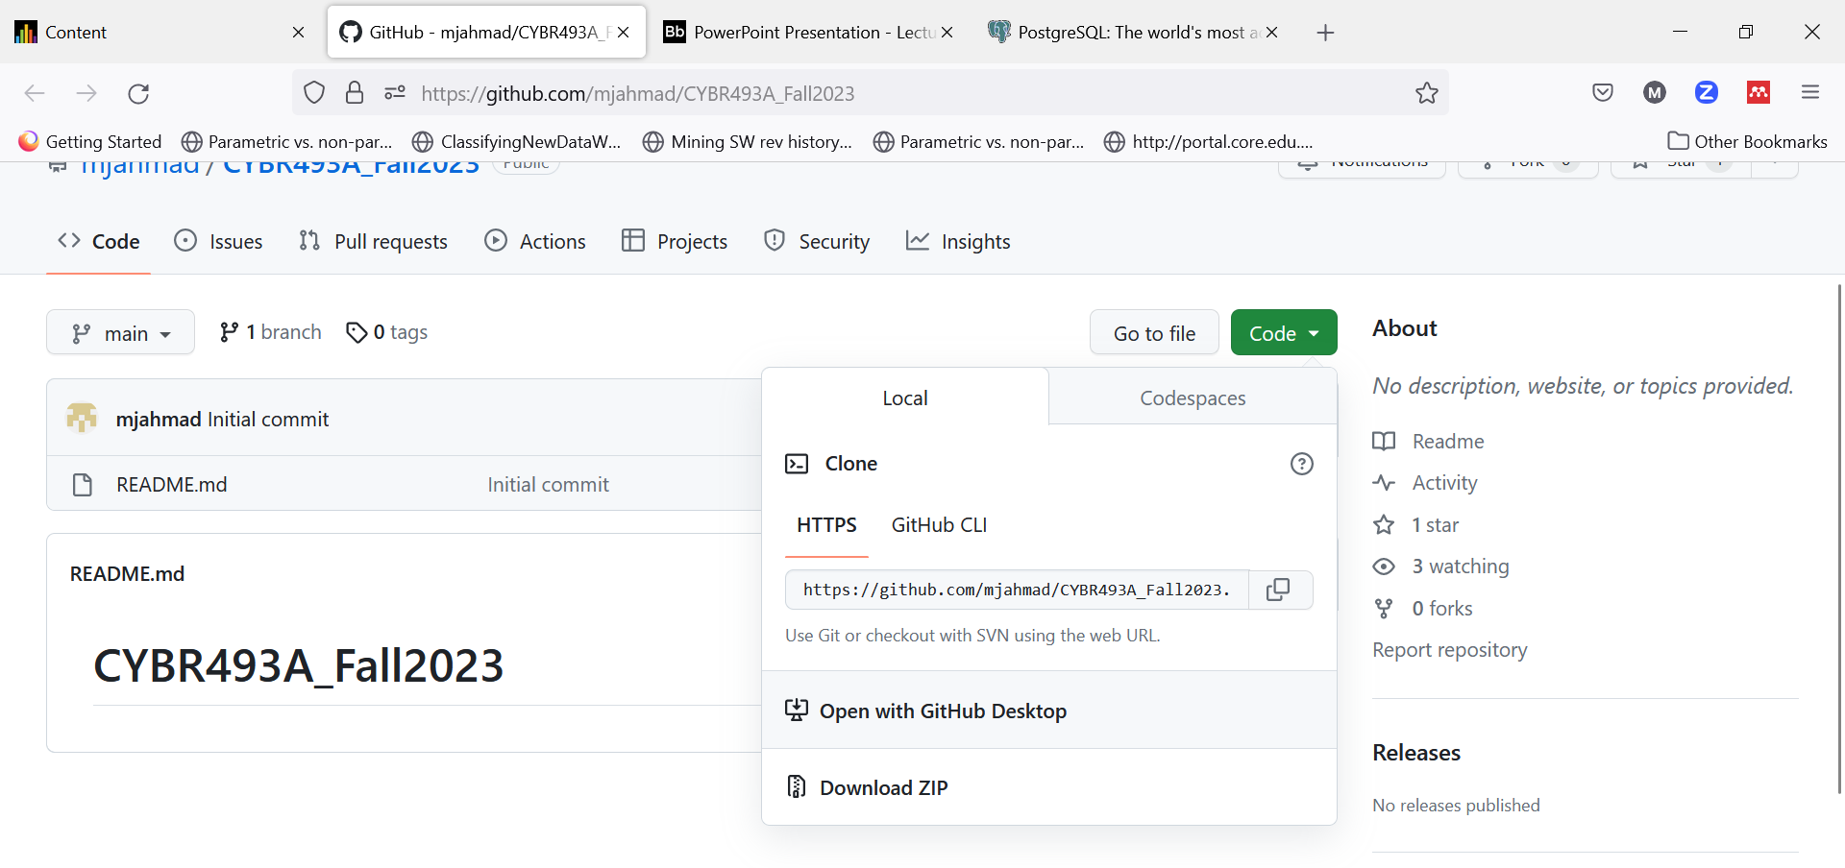
Install Desktop GitHub
Direct download and installation.
Then clone class’s repo to your local machine
Get the link from our Repo, copy link
Then in Desktop GitHub, clone.

Slide 12
Cloning our repo
In the web browser, go to https://github.com/mjahmad/CYBR520_Fall2023.git , this is the our main repository, it also has the source code for the sample files in the text books.

Slide 13
Joining GitHub
Create an account on github, using your mix account.
Download and install Github Desktop
Create your own private repo
Name is [Your First Name]_[Your Last Name]_CYBR520_Fall23.
Add Dr. Ahmad[mahmad2@mix.wvu.edu] as a contributor
Clone your own repo to your local machine
Clone our class Repo.

Slide 14
Introduction to Python
Python is a “programming”/scripting language initially developed in 1989 by Guido van Rossum.
Many of main tenants for the Python programming language center around readability and simplicity, which has made it extremely accessible and easy to use.
Python is meant to be “fun to use” ☺

Slide 15
Introduction to Python
In recent years, the flexibility and usability of Python has resulted in its use growing rapidly.
Python has become a critical skill to know in several realms including:
Networking
cyber-security
systems management
data scientists
artificial intelligence

Slide 16
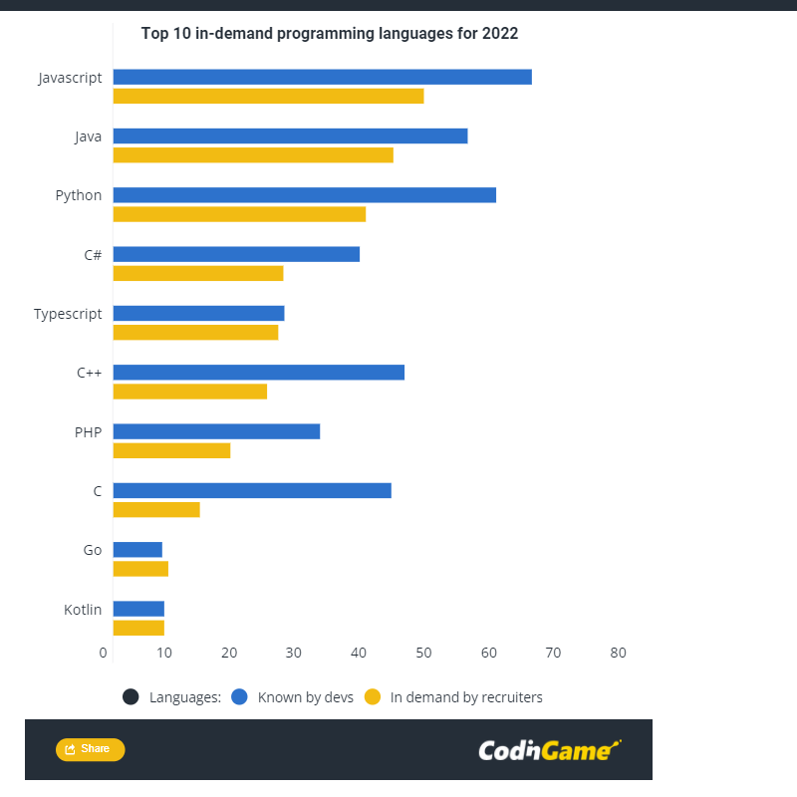
Introduction to Python

Slide 17
Simplest way to create a python file
We write source code and save them in files.
These are known as source code files
Source code files are nothing but text documents with fancy extensions:
Python => .py
C ++ => .cpp
Java => .java
What do you think extensions are used for?

Slide 18
Keep in mind
Your computer does not understand what Python/ Java/ C++ is.
For each programming/ scripting language, the OS needs a program understand it and execute it.
These are named compilers/ interpreter.
This is what we mean when we say, install Python.

Slide 19
Source code: file extensions
Each file consists of two parts:
Name
Extension
The extension tells the Operating System (and users) what kind of file this is
Also allows the PS to use certain programs (compiler/ interpreter) to run the file.

Slide 20
Create and commit the following files
One file named [your first name_last name.py]
One file named [your first name_last name.java]
If Python and Java are installed, these files should have different icons:
To check whether you have Python installed:
Go to Run => type cmd => type python and hit enter
You should see a black screen with >> waiting for input, otherwise, you will need to install python.

